Slide 1
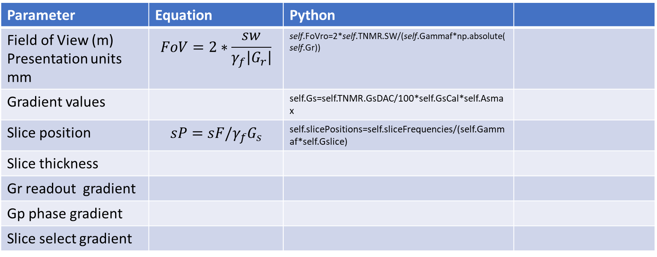
Se equations
Parameter | Equation | Python
Field of View (m) Presentation units mm | $$FoV=2∗\frac{sw}{γ_{f}\left|G_{r}\right|}$$ | self.FoVro=2*self.TNMR.SW/(self.Gammaf*np.absolute(self.Gr))
Gradient values |  | self.Gs=self.TNMR.GsDAC/100*self.GsCal*self.Asmax
Slice position | $$sP=sF/γ_{f}G_{s}$$ | self.slicePositions=self.sliceFrequencies/(self.Gammaf*self.Gslice)
Slice thickness
Gr readout gradient
Gp phase gradient
Slice select gradient

